Slide 1
TJAGLCS Training Package
Nonjudicial Punishment and Article 15s
November 2024

Slide 2
NJP References
Article 15, UCMJ (10 U.S.C. § 815)
“Commanding Officer’s non-judicial punishment”
MCM, Part V (Executive Order)
“Nonjudicial Punishment Procedure”
AR 27-10, Military Justice (2024)
Chapter 3
Chapter 20, Section III (Reserves)
Appendix C
Script
Notes:
Updated references for 2024 MCM.

Slide 3
Class Roadmap
Nonpunitive Corrective Measures
Nonjudicial Punishment
Purpose
Changes – Burden of Proof and Working with OSTC
Command Authority and Other Limitations
Procedures
Conclusion

Slide 4
Nonjudicial versus Nonpunitive
MCM, Part V, para. 1(d)(1)
AR 27-10, para. 3-2
Notes:
The purpose behind this slide is to drive home the point that our references state commanders SHOULD use nonpunitive measures whenever possible. However, the command still has discretion for non-covered offenses.

Slide 5
What Constitutes Nonpunitive?
Denial of pass or other privileges
Counseling
Administrative reduction in grade
Administrative reprimands and admonitions
Corrective training
Bar to continued service
MOS reclassification
AR 27-10, para. 3-3a
Notes:
The purpose behind this slide is to lay out some of the nonpunitive measures available to commanders. This slide can also be used to teach the difference between a black letter, legal definition and command/Soldier perception of something like “nonpunitive” as it relates to something like a GOMOR which is critical in giving command advice.

Slide 6
When to Use Nonjudicial Punishment
Ordinarily Appropriate when:
Administrative corrective measures are inadequate
To address a minor offense
It may be appropriate to skip corrective training and go straight to an Article 15 based on the nature of offense and record of service member.
MCM, Part V, para. 1(d)(1)

Slide 7
4 “Types” of NJP
Summarized
No $$$$$
Local File only
Company Grade
7 days pay
Can’t Reduce NCO
Field Grade
Can reduce NCOs
General Officer
$$$$$
Arrest in Quarters
Usually done by Battalion CDR
Notes:
This slide is a basic illustration of the escalation of punishments available at various levels of NJP and why commanders may elect a particular “type” of NJP.

Slide 8
Non-Judicial Punishment aka Article 15
Purpose:
Correct, educate, and reform offenders
Preserve a Soldier’s record from the unnecessary stigma of a court-martial conviction
Further military efficiency by disposing of minor offenses in a manner requiring less time and personnel than trial by court-martial.
AR 27-10, para. 3-2

Slide 9
What is a Minor Offense
Ordinarily, an offense for which the maximum sentence would not include a DD or confinement for >1 year if tried by GCM but…….
AR 27-10 & MCM says Command discretion!
What about sexual offenses?
OSTC became FOC on 28 Dec 23. OSTC has exclusive authority over covered sexual offenses until deferred. After deferral, there are limitations on the command which will be discussed in the next slide.
MCM, Part V, para. 1(3)
AR 27-10, para. 3-9

Slide 10
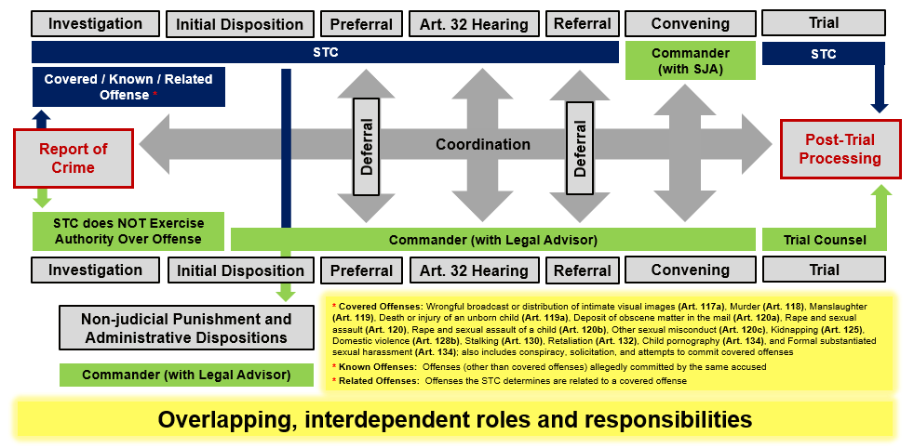
Office of the Special Trial Counsel
Everything in red is off the table for the command after deferral. Article 15s and SCM are available to commanders WITH OSTC coordination.
Notes:
The purpose of this slide is to illustrate the dual command and OSTC tracks upon the commission of a crime, a subsequent deferral back to the command, and the limitations on a command – specifically, no SPCM or GCM; SCM and NJP only available to command after coordination with OSTC. It is worth noting that these require coordination because the accused Soldier has the right to turn these down and ask for CM.

Slide 11
Non-Judicial Punishment Burden of Proof
ONE OFFENSE PRIOR TO EO
BARD
BEFORE THE EO
BARD
AFTER THE EO
PREPONDERANCE
29 July 2023
While the burden of proof (if all offenses occurred after 29 July 2023)
has changed to preponderance of the evidence, judge advocates
should still check packets for a beyond a reasonable doubt standard
in order to avoid issues should a Soldier opt to exercise their right to
trial by court-martial.
TURNDOWN
CM - BARD
Notes:
The purpose behind this slide is to build out the standards of proof at an Article 15 based upon the date the alleged offense occurred. That said, it should also be used to highlight that even though commanders are able to use the lower preponderance of the evidence standard in making their decision, JAs should still be preparing packets as thought they are going to court-martial. A commander may lose trust in a JA’s advice if the Article 15 was a “sure thing” but the Soldier’s decision to turn the Article 15 down has resulted in a court-martial that is anything but a “sure thing.”

Slide 12
Authority
Check for local withholding policies!
Reserve Component Officer withholding – AR 27-10, para. 20-6
Officers in the Reserves will be processed as GO Article 15s
Senior Leader
Specific withholding by offense type (e.g. drug distribution)
Can request delegation from superior commander
Commanders
Soldiers assigned to the organization or attached for “disciplinary purposes”. When in doubt, read the Soldier’s orders.
Beware of assumption of command orders-have a plan!
AR 27-10, para. 3-8

Slide 13
More Limitations
Statute of Limitations- 2 years
See updated MCM, Part V, para. 1f.(4) incorporating Article 43(c)&(d)
No Double Jeopardy (can still Court-Martial)
Offenses being prosecuted by civilian authorities (e.g. DUI/DWI or domestic violence)
GCMCA can authorize IAW the procedures in Chapter 4
UCI applies to Article 15s
AR 27-10, para. 4-3 MCM, Part V, para. 1
Notes:
This slide highlights one change in the new MCM and that is the incorporation of tolling the statute of limitations for AWOL and being absent from military jurisdiction. The other major note on this slide that may not be evident is that while NJP can be given to Soldiers facing civil prosecution in State court, not Federal court, JAs must consult Chapter 4 and its requirements to request authority to do so through the SJA to the GCMCA.

Slide 14
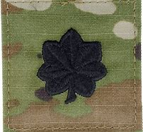
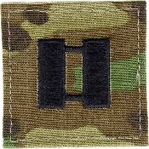
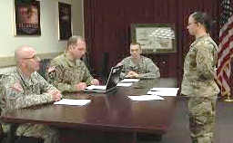
Procedure
Signed by
Only reads
Notification/
First Reading
Formal Hearing
Appeal?
TDS

Slide 15
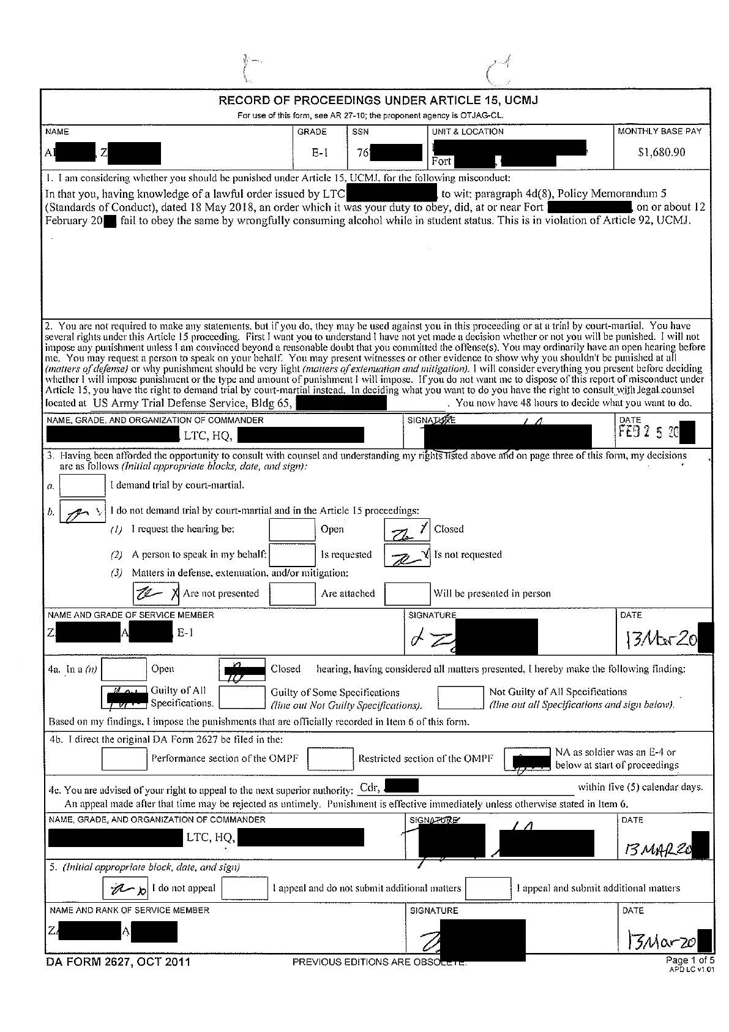
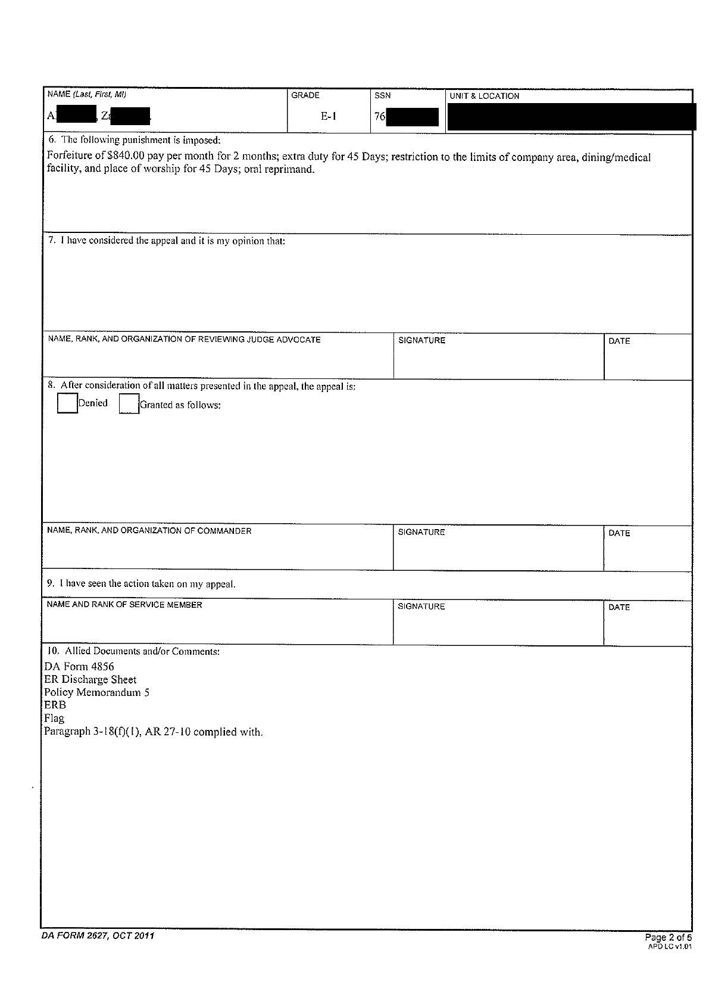
First Reading and TDS
First Reading
TDS

Slide 16
Common Misconceptions
Accepting Art 15 = guilt
Misspellings & clerical errors invalidate the Art 15
Accused doesn’t get to see a copy of the packet
Only need some evidence for guilty finding
If you turn it down, you won’t get CM’d.

Slide 17
Hearing
Decision
Accept or “turn down”
Hearing
Commander = judge and jury
Open or closed
Spokesperson role
Witnesses and evidence
MREs do not apply!
Findings and (punishment)
AR 27-10, para. 3-18
MCM, Part V, paras. 3 & 4

Slide 18
Second Reading/ Hearing
Hearing

Slide 19
Filing Determination
Local or AMHRR (restricted and performance)
AMHRR – Army Military Human Resource Record (AR 600-8-104)
Sex related = performance folder
Again, please remember this should only occur after deferral and consultation with OSTC
Otherwise
E1-E4 – local
E5 and above – AMHRR
Limited to one restricted filing
Superior can direct restricted filing
AR 27-10, paras. 3-6 and 3-37
AR 600-8-104

Slide 20
Filing Determination
Filing Det.

Slide 21
Max Punishment
If combined becomes 45
If combined becomes 45

Slide 22
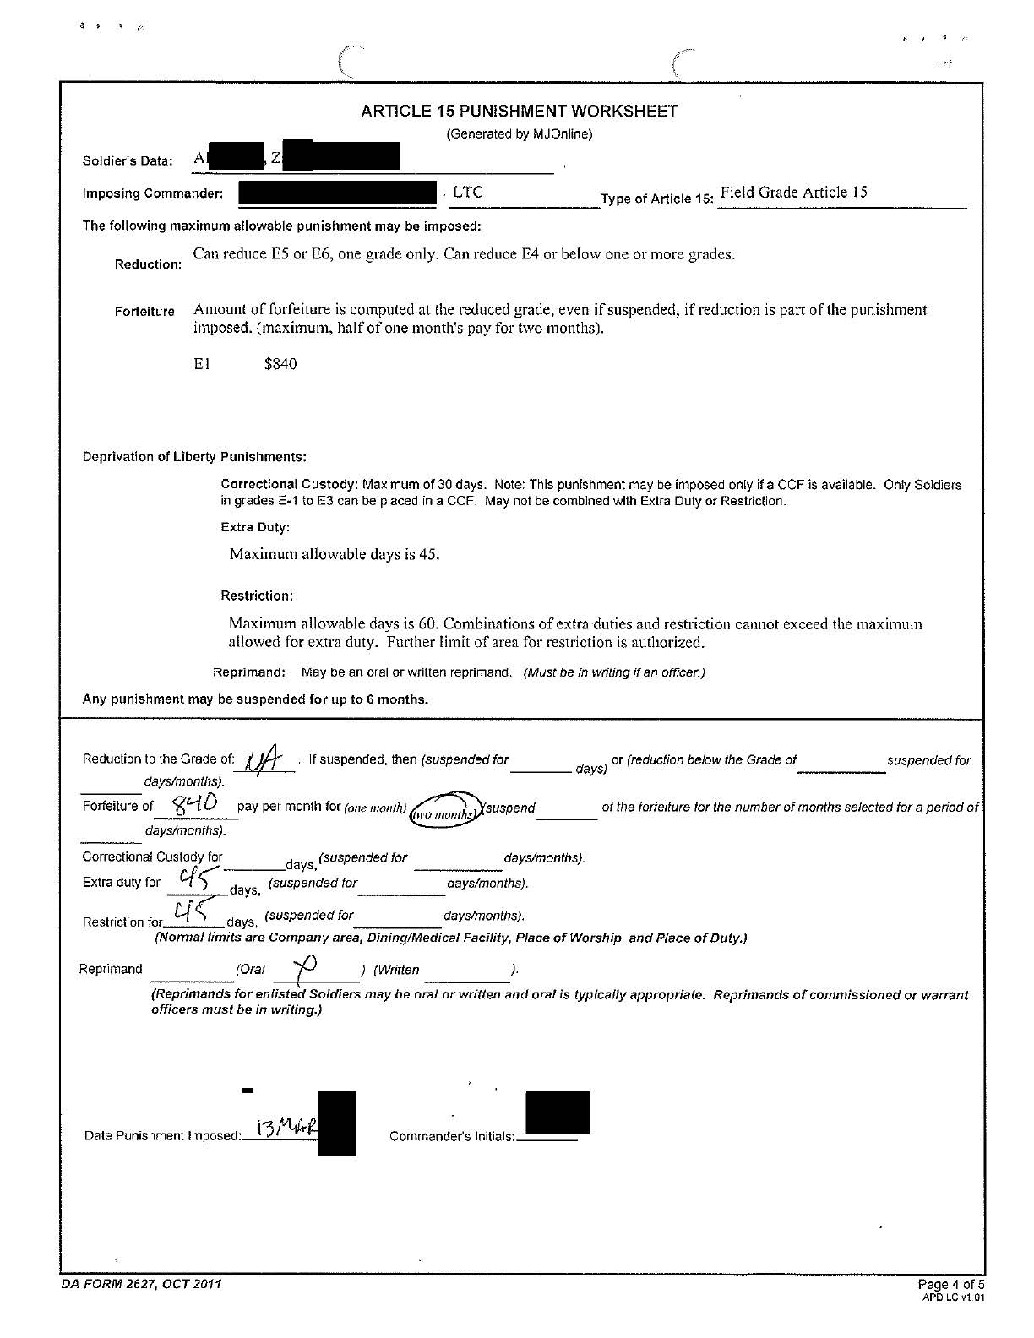
Punishment
Typed after
Cheat Sheet
Decision

Slide 23
Appeals
Submitted through the imposing commander to the next superior commander!
Written matters optional
May suspend, mitigate, remit, set aside
Rehearing is possible
Legal review may be required
Depends upon nature and level of punishment
No legal review required for Summarized!
AR 27-10, paras. 3-29-35
MCM, Part V, para. 7

Slide 24
Clemency/Appellate Options
Imposing commander, successor-in-command, or next superior authority all have clemency authority
Suspension
Like probation
Remission
Cancel remaining punishment
Mitigation
Reduce quantity or quality of punishment
Set Aside/Restore
Can totally or partially set aside the punishment or the findings.
If new misconduct, then vacate suspension and impose punishment/s.
AR 27-10, paras. 3-23-28
MCM, Part V, para. 6
Notes:
The purpose of this slide is to illustrate the increasing clemency powers the commander has (left-to-right).

Slide 25
Suspended Punishments
180 days!
Yes, but….
Forfeitures and Reductions can only be suspended for four months. Summarized proceedings capped at 90 days.
All other punishments can be suspended up to 180 days.

Slide 26
Appeals
Judge Advocate
Sup. Commander
Soldier

Slide 27
To Post or Not to Post?
AD 2022-13
Notes:
Posting of NJP is required for sexual harassment and sex-related offenses according to AR 27-10, para. 3-22. However, the regulation is actually narrower than Army Directive 2022-13 which requires posting of administrative actions as well.

Slide 28
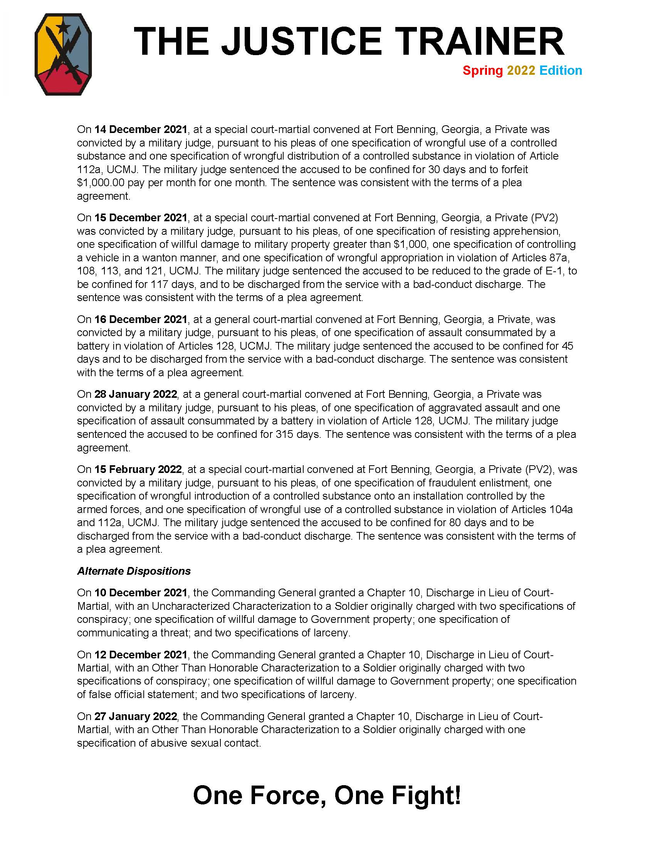
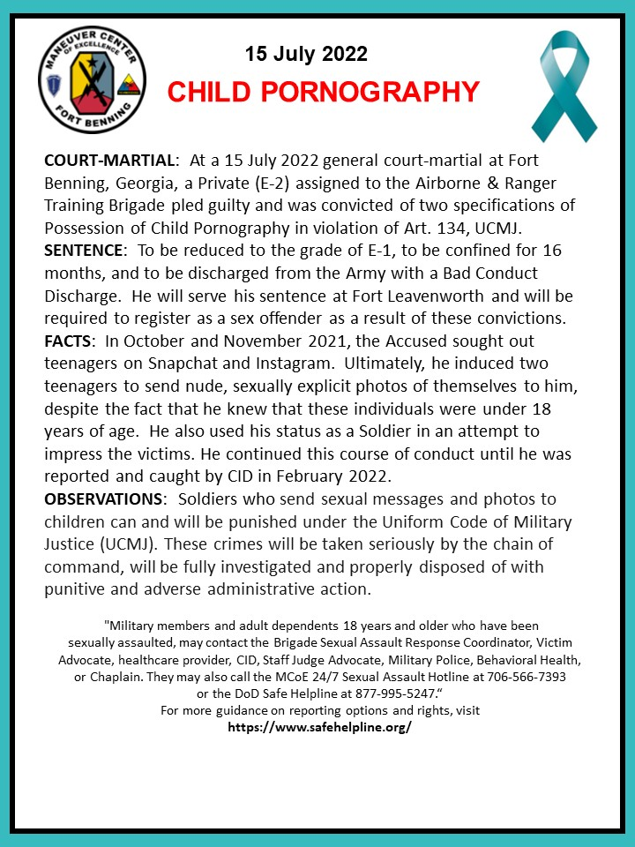
Notes:
Examples of bulletin board newsletters.

Slide 29
Need Training Materials?
Have Training Materials?
Questions?
Contact Us!
TJAGLCS-training@army.mil

